Slide 1
Shop For Home
Guided By Group Members
Mr. Javeed Husnuddin 1)Soumyadeep Maji
2)Lalit Mathariya
3)Vishal Patil
4)Swapnil Bhusnur
5)Shubh Sharma

Slide 2
Web Based Shop For Home
The Web Based Shop For Home project mainly focuses on basic operations adding new product,new member and updating new information ,searching product and members and facility to online shopping.
Shop For Home is the process whereby consumers directly buy goods,services,etc. from a seller interactively in real-time without an intermediary service over the internet.
It helps buying the products in the shop anywhere through internet by using an android device. Thus the customer will get the service of online shopping and home delivery from his favorite shop.

Slide 3
TECHNOLOGIES AND TOOLS USED
TECHNOLOGIES:
Front-End: HTML, CSS, JAVASCRIPT, BOOTSTRAP, ANGULAR 8
Back-End: SPRINGBOOT, HIBERNATE
TOOLS:
Front-End: Visual Studio Code
Back-End: STS4(Spring Tool Suite 4), MySQL Workbench 8.0CE
Browser: Google Chrome For Development
Server: Tomcat Server(Port : 8080)
API Services: Swagger

Slide 4
Project objective
The objective of the project is to make an application in android platform to purchase items in an existing shop. In order to build such an application complete web support need to be provided.
A complete and efficient web application which can provide the online shopping experience is the basic objective of the project.
The central concept of the application is to allow the customer to shop virtually using the Internet and allow customers to buy the items and articles of their desire from the store.
The information pertaining to the products are stores on an RDBMS at the server side (store).
The Server process the customers and the items are shipped to the address submitted by them. The application was designed into two modules first is for the customers who wish to buy the articles.

Slide 5

Modules
The system after careful analysis has been identified to be presented with the following modules and roles. The modules involved are:
1.Admin
2. Product
3. Users
ADMIN: The administrator is the super user of this application. Only admin have access into this admin page. Admin may be the owner of the shop. The administrator has all the information about all the users and about all products.
This module is divided into different sub-modules.
1) Manage Moderators 4. Manage Orders 3) Manage Products
4) Manage Users

Slide 6
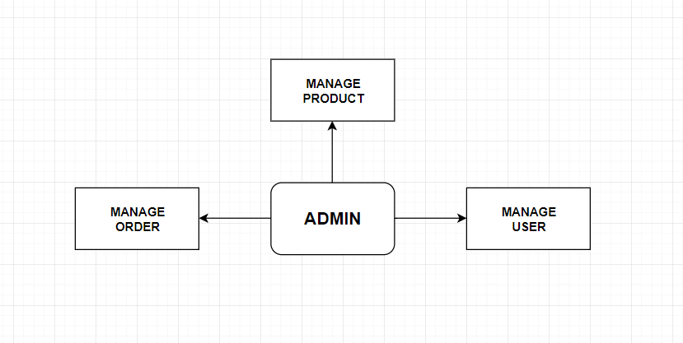
Admin module

Slide 7
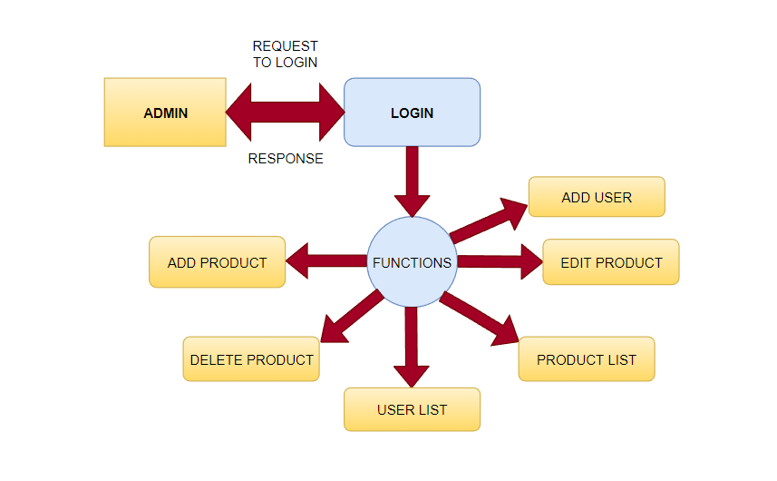
DATA FLOW DIAGRAM FOR ADMIN

Slide 8
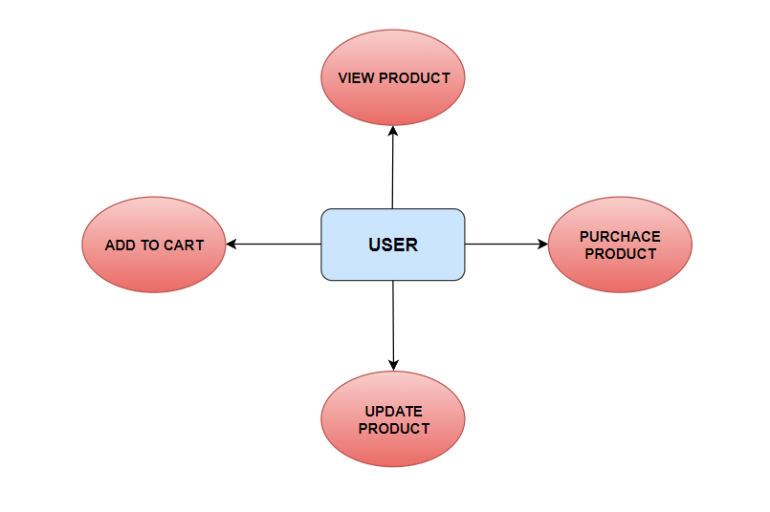
USERS
Fig : User Module
View Products : User can view the list of products based on their names after successful login. A detailed description of a particular product with product name, products details, product image, price can be viewed by users.

Slide 9
Add to cart : The user can add the desired product into his cart by clicking add to cart option on the product. He can view his cart by clicking on the cart button. All products added by cart can be viewed in the cart. User can remove an item from the cart by clicking remove.
Submit Cart : After confirming the items in the cart the user can submit the cart by providing a delivery address.On successful submitting the cart will become empty.
Purchase Product : In the profile of the user get added purchased product.
Update Product : The user can update the product.

Slide 10
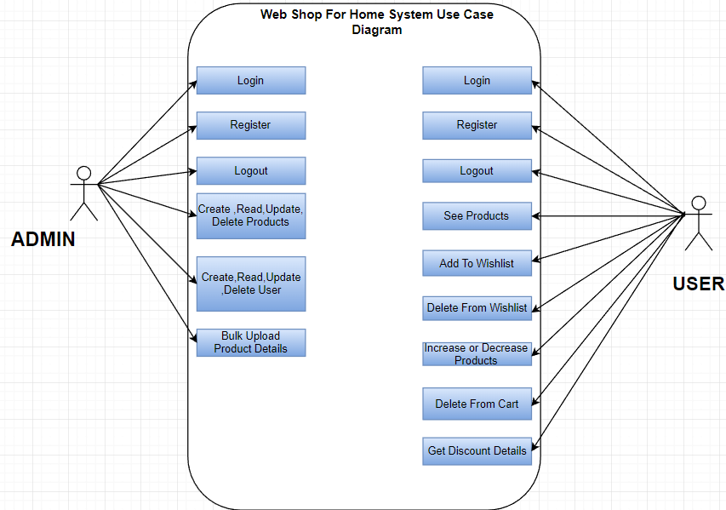
User case diagram for customer and Admin

Slide 11
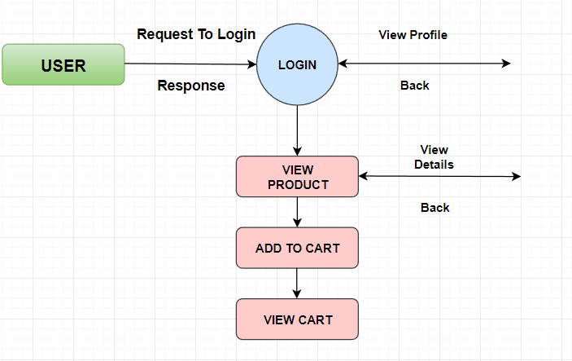
DATA FLOW DIAGRAM FOR USER LOGIN

Slide 12
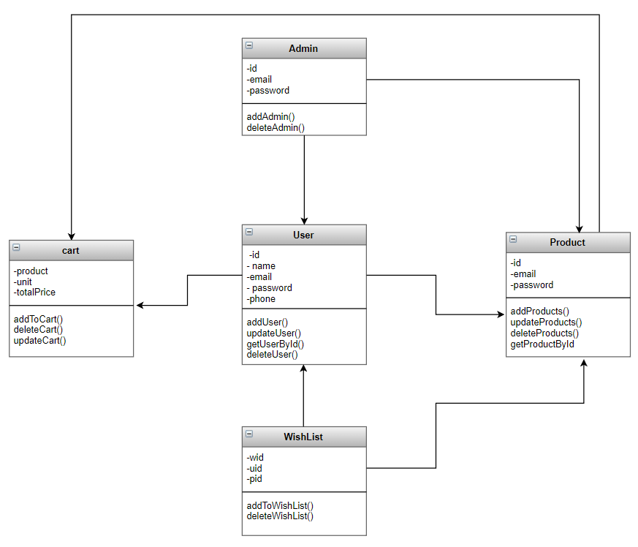
UML Diagram

Slide 13
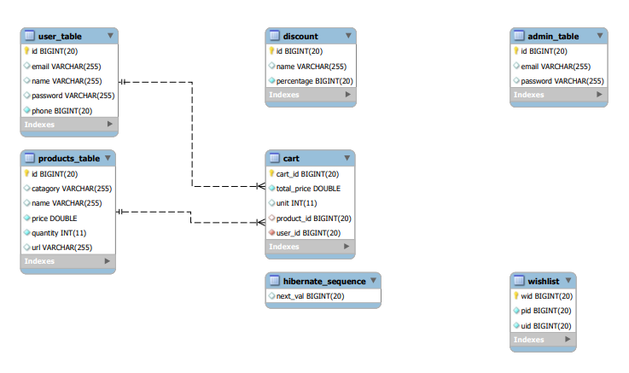
ER-Diagram

Slide 14
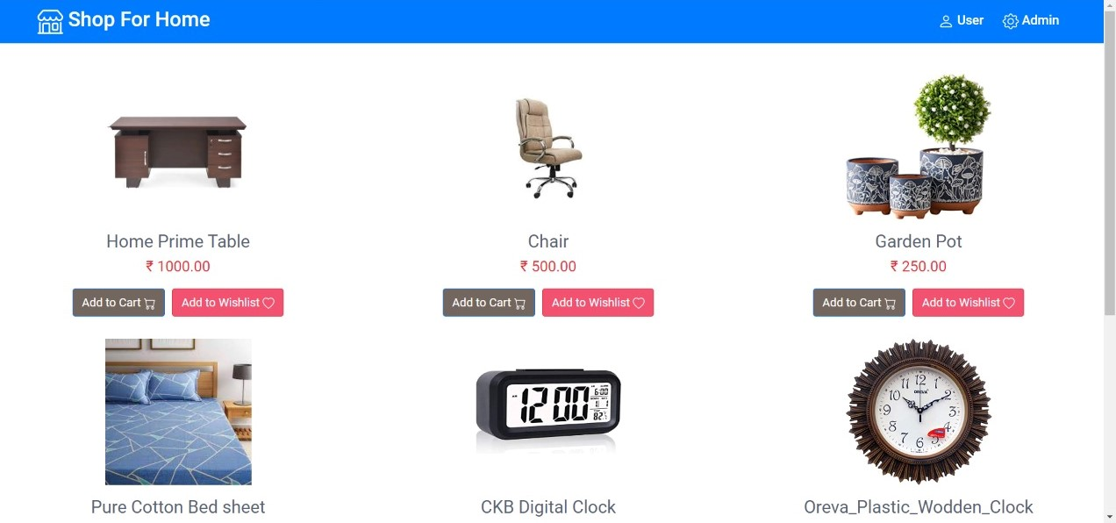
Home Page

Slide 15
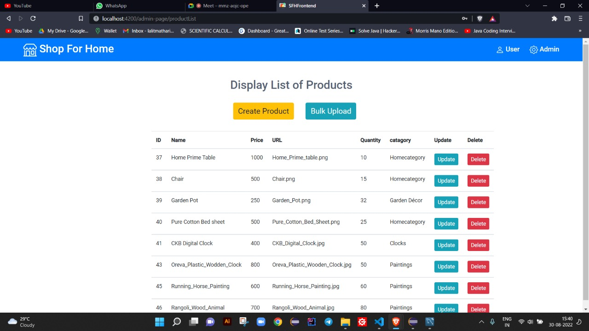
Admin Product Management

Slide 16
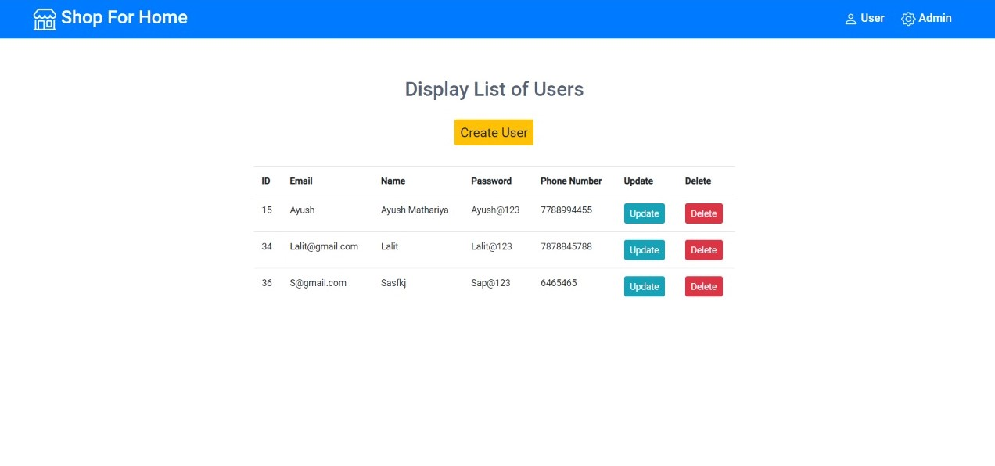
User Product Management

Slide 17
FUNCTIONAL REQUIREMENTS
USER
User Login
Description of feature : This feature used by the user to login into system. A user must login with his user name and password to the system after registration. If they are invalid, the user not allowed to enter the system.
Functional requirement :
-Username and password will be provided after user registration is confirmed.
-Password should be hidden from others while typing it in the field.
Register New User
Description of feature : A new user will have to register in the system by providing essential details in order to view the products in the system. The admin must accept a new user by unblocking him.

Slide 18
Functional requirement :
System must be able to verify and validate information.
The system must encrypt the password of the customer to provide security.
Purchasing An Item
Description of feature : The user can add the desired product into his cart by clicking add to cart option on the product. He can view his cart by clicking on the cart button. All products added by cart can be viewed in the cart. User can remove an item from the cart by clicking remove. After confirming the items in the cart the user can submit the cart by providing a delivery address. On successful submitting the cart will become empty.
Functional requirement :
- System must ensure that, only a registered customer can purchase items.

Slide 19
conclusion
The system has been developed with much care and free of errors and at the same time it is efficient and less time consuming.
The purpose of this project was to develop a web application and an android application for purchasing items from a shop.
This project helped us in gaining valuable information and practical knowledge on several topics like designing web pages using html & css, usage of responsive templates, designing of android applications, and management of database using mysql .
The entire system is secured. Also the project helped us understanding about the development phases of a project and software development life cycle. We learned how to test different features of a project.

Slide 20
THANK YOU

